Slide 1
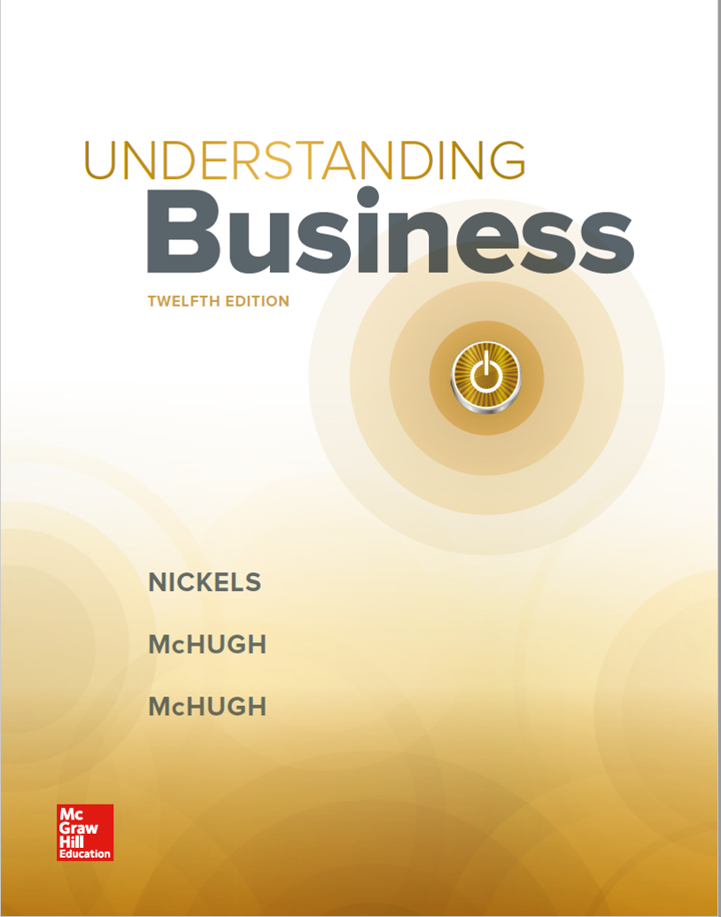
Chapter 19
Using Securities Markets for Financing and Investing Opportunities

Slide 2
Learning Objectives 1 of 2
LO 19-1 Describe the role of securities markets and of investment bankers.
LO 19-2 Identify the stock exchanges where securities are traded.
LO 19-3 Compare the advantages and disadvantages of equity financing by issuing stock, and detail the differences between common and preferred stock.
LO 19-4 Compare the advantages and disadvantages of obtaining debt financing by issuing bonds, and identify the classes and features of bonds.

Slide 3
Learning Objectives 2 of 2
LO 19-5 Explain how to invest in securities markets and set investment objectives such as long-term growth, income, cash, and protection from inflation.
LO 19-6 Analyze the opportunities stocks offer as investments.
LO 19-7 Analyze the opportunities bonds offer as investments.
LO 19-8 Explain the investment opportunities in mutual funds and exchange-traded funds (ETFs).
LO 19-9 Describe how indicators like the Dow Jones Industrial Average affect the market.

Slide 4
The Function of Securities Markets 1 of 2
Securities markets are financial marketplaces for stocks and bonds and serve two primary functions:
Assist businesses in finding long-term funding to finance capital needs
Provide private investors a place to buy and sell securities such as stocks and bonds
Types of Securities Markets
Primary markets handle the sale of new securities.
Secondary markets handle the trading of securities between investors, with the proceeds of the sale going to the seller.
LO 19-1

Slide 5
The Function of Securities Markets 2 of 2
Initial public offering (IPO) — The first public offering of a corporation’s stock.
The Role of Investment Bankers
Investment bankers — Specialists who assist in the issue and sale of new securities.
Institutional investors — Large organizations, such as pension funds or mutual funds, that invest their own funds or the funds of others.
LO 19-1

Slide 6
Stock Exchanges 1 of 2
Stock exchange — An organization whose members can buy and sell (exchange) securities for companies and investors.
Over-the-counter (OTC) market — Exchange that provides a means to trade stocks not listed on the national exchanges.
NASDAQ — A nationwide electronic system that communicates over-the-counter trades to brokers.
LO 19-2

Slide 7
Stock Exchanges 2 of 2
Securities Regulations and the Securities and Exchange Commission
Securities and Exchange Commission (SEC) — Federal agency that has responsibility for regulating the various exchanges.
It was created in 1934 through the Securities and Exchange Act.
Prospectus — A condensed version of economic and financial information that a company must file with the SEC before issuing stock; the prospectus must be sent to prospective investors.
Foreign Stock Exchanges
Investors can buy securities from companies almost anywhere in the world.
Foreign investors can also invest in U.S. securities.
LO 19-2

Slide 8
How Businesses Raise Capital by Selling Stock 1 of 4
Stocks — Shares of ownership in a company.
Stock certificate — Evidence of stock ownership that specifies the name of the company, the number of shares it represents, and the type of stock being issued.
Dividends — Part of a firm’s profits that the firm may distribute to stockholders as either cash payments or additional shares of stock.
LO 19-3

Slide 9
How Businesses Raise Capital by Selling Stock 2 of 4
Advantages of Issuing Stock
Stockholders are owners of a firm and never have to be repaid their investment.
There is no legal obligation to pay dividends.
Issuing stock can improve a firm’s balance sheet since stock creates no debt.
LO 19-3

Slide 10
How Businesses Raise Capital by Selling Stock 3 of 4
Disadvantages of Issuing Stock
Stockholders have the right to vote for a company’s board of directors. Issuing new shares of stock can thus alter the control of the firm.
Dividends are paid from after-tax profits and are not tax-deductible.
The need to keep stockholders happy can affect managers’ decisions.
LO 19-3

Slide 11
How Businesses Raise Capital by Selling Stock 4 of 4
Issuing Shares of Common Stock
Common stock — The most basic form of ownership in a firm; it confers voting rights and the right to share in the firm’s profits through dividends.
Issuing Shares of Preferred Stock
Preferred stock — Stock that gives its owners preference in the payment of dividends and an earlier claim on assets than common stockholders.
Preferred stock can also be:
Callable
Convertible
Cumulative
LO 19-3

Slide 12
How Businesses Raise Capital by Issuing Bonds 1 of 5
Learning the Language of Bonds
Bond — A corporate certificate indicating that a person has lent money to a firm.
Principal — The face value of the bond.
Maturity date — The exact date the issuer of a bond must pay the principal to the bondholder.
Interest — The payment the issuer makes to the bondholders for use of the borrowed money.
LO 19-4

Slide 13
Figure 19.2 Types of Government Securities that Compete with Corporate Bonds
LO 19-4
Jump to long description in appendix

Slide 14
How Businesses Raise Capital by Issuing Bonds 2 of 5
Advantages of Issuing Bonds
Bondholders are creditors, not owners, of the firm and cannot vote on corporate matters.
Bond interest is tax-deductible.
Bonds are a temporary source of funding and are eventually repaid.
Bonds can be repaid before the maturity date if they are callable.
LO 19-4

Slide 15
How Businesses Raise Capital by Issuing Bonds 3 of 5
Disadvantages of Issuing Bonds
Bonds increase debt and can affect the market’s perception of the firm.
Paying interest on bonds is a legal obligation. If interest is not paid, bondholders can take legal action.
The face value of the bond must be repaid on the maturity date.
LO 19-4

Slide 16
Figure 19.3 Bond Ratings
Moody’s | Standard & Poor’s | Fitch Ratings | Descriptions
Aaa | AAA | AAA | Highest quality (lowest default risk)
Aa | AA | AA | High quality
A | A | A | Upper medium grade
Baa | BBB | BBB | Medium grade
Ba | BB | BB | Lower medium grade
B | B | B | Speculative
Caa | CCC, CC | CCC | Poor (high default risk)
Ca | C | DDD | Highly speculative
C | D | D | Lowest grade
LO 19-4

Slide 17
How Businesses Raise Capital by Issuing Bonds 4 of 5
Different Classes of Bonds
Unsecured bonds (debenture bonds) are not backed by specific collateral.
Secured bonds are backed by collateral such as land or equipment.
LO 19-4

Slide 18
How Businesses Raise Capital by Issuing Bonds 5 of 5
Special Bond Features
Sinking fund — Reserve account in which the issuer periodically retires some part of the bond principal prior to maturity so that enough capital will be accumulated by the maturity date.
Callable bonds permit bond issuers to pay off the principal before the maturity date.
Convertible bonds allow bondholders to convert their bonds into shares of common stock.
LO 19-4

Slide 19
How Investors Buy Securities 1 of 3
Stockbroker — A registered representative who works as a market intermediary to buy and sell securities for clients.
Investing through Online Brokers
Online trading services, such as TD Ameritrade, E*Trade, and Fidelity, offer securities trading services online to buy and sell stocks and bonds.
Online brokers can charge much lower trading fees.
LO 19-5

Slide 20
How Investors Buy Securities 2 of 3
Choosing the Right Investment Strategy
Consider five criteria when selecting investment options:
Investment risk
Yield
Duration
Liquidity
Tax consequences
LO 19-5

Slide 21
How Investors Buy Securities 3 of 3
Reducing Risk by Diversifying Investments
Diversification — Buying several different investment alternatives to spread the risk of investing.
If diversifying, an investor may put:
25 percent of his or her money into U.S. growth stocks
25 percent in government bonds
25 percent in dividend-paying stocks
10 percent in an international mutual fund
The rest in a savings account
LO 19-5

Slide 22
Investing in Stocks 1 of 4
Perceptions of the Market
Bulls — Investors who believe stock prices are going to rise.
Bears — Investors who expect stock prices to decline.
Selecting Stocks
Capital gains — The positive difference between purchase price of a stock and its sale price.
Investors can also choose stocks according to their strategy:
Blue-chip stocks
Growth stocks
Income stocks
Penny stocks
LO 19-6

Slide 23
Investing in Stocks 2 of 4
Stock Splits
Stock splits — An action by a company that gives stockholders two or more shares of stock for each one they own.
Splits cause no change in the firm’s ownership structure and no immediate change in the investment’s value.
Firms can never be forced to spilt their stocks.
LO 19-6

Slide 24
Investing in Stocks 3 of 4
Buying Stock on Margin
Buying stock on margin — Purchasing stocks by borrowing some of the purchase cost from the brokerage firm.
Margin is the portion of the stock’s purchase price that the investor must pay with their own money.
If a broker issues a margin call, the investor has to come up with money to cover losses.
LO 19-6

Slide 25
Investing in Stocks 4 of 4
Understanding Stock Quotations
Information in a quote includes:
Highest and lowest price for that day
High and low over the past 52 weeks
Dividend paid
Dividend yield
Ratios such as price/earnings ratio
Earnings per share
Number of shares traded
LO 19-6

Slide 26
Figure 19.4 Understanding Stock Quotations
LO 19-6
Jump to long description in appendix

Slide 27
Investing in Bonds
First-time bond investors generally ask two questions:
Do I have to hold a bond until the maturity date?
How can I assess the investment risk of a particular bond issue?
Investing in High-Risk (Junk) Bonds
Junk bonds — High-risk, high-interest bonds.
LO 19-7

Slide 28
Investing in Mutual Funds and Exchange-Traded Funds
Mutual fund — An organization that buys stocks and bonds and then sells shares in those securities to the public.
The fund pools investors’ money and buys stocks according to the fund’s purpose.
Exchange-traded funds (ETFs) — Collections of stocks that are traded on exchanges but are traded more like individual stocks than like mutual funds.
LO 19-8

Slide 29
Figure 19.6 Comparing Investments
Investment | Degree of Risk | Expected income | Possible growth (capital gain)
Bonds | Low | Secure | Little
Preferred stock | Medium | Steady | Little
Common stock | High | Variable | Good
Mutual funds | Medium | Variable | Good
ETFs | Medium | Variable | Good
LO 19-8

Slide 30
Understanding Stock Market Indicators 1 of 4
Dow Jones Industrial Average (the Dow) — The average cost of 30 selected industrial stocks, used to give an indication of the direction of the stock market over time.
Critics say the 30-company Dow is too small a sample and suggest following the S&P 500.
S&P 500 tracks the performance of 400 industrial, 40 financial, 40 public utility, and 20 transportation stocks.
LO 19-9

Slide 31
Figure 19.7 The Original Dow and Current Dow
LO 19-9
Jump to long description in appendix

Slide 32
Understanding Stock Market Indicators 2 of 4
Riding the Market’s Roller Coaster
October 29, 1929 — Black Tuesday; the market lost 13 percent of its value.
October 19, 1987 — The market suffered its worst one-day drop when it lost 22 percent of its value.
October 27, 1997 — Fears of an economic crisis in Asia cause widespread panic and losses.
LO 19-9

Slide 33
Understanding Stock Market Indicators 3 of 4
Riding the Market’s Roller Coaster continued
The market collapsed into a deep decline in 2000 through 2002 when the tech stock bubble burst.
Investors lost 7 trillion dollars in market value.
Starting in 2008, the financial crisis fueled a massive exodus from the stock market, resulting in record losses.
LO 19-9

Slide 34
Understanding Stock Market Indicators 4 of 4
Riding the Market’s Roller Coaster continued
Program trading — Giving instructions to computers to automatically sell if the price of a stock dips to a certain point to avoid potential losses.
Analysts believe program trading caused the turmoil in 1987.
The exchanges created mechanisms called curbs and circuit breakers to restrict program trading.
LO 19-9

Slide 35
Figure 19.8 Cleaning Up the Street
Key Dodd-Frank Provisions
Gave the government power to seize and shutter large financial institutions on the verge of collapse.
Put derivatives and complicated financial deals (including those that packaged subprime mortgages) under strict governmental oversight.
Required hedge funds to register with the SEC and provide information about trades and portfolio holdings.
Created the Consumer Financial Protection Bureau to watch over the interests of American consumers by reviewing and enforcing federal financial laws.
LO 19-9

Slide 36
Appendix of Long Image Descriptions

Slide 37
Appendix 1 Figure 19.2 Types of Government Securities that Compete with Corporate Bonds
U.S. government bond: Issued by the federal government; considered the safest type of bond investment
Treasury bill (T-bill): Matures in less than a year; issued with a minimum denomination of one thousand dollars
Treasury note: Matures in 10 years or less; sold in denominations of one thousand dollars up to one million dollars
Treasury bond: Matures in 25 years or more; sold in denominations of one thousand dollars up to one million dollars
Municipal bond: Issued by states, cities, counties, and other state and local government agencies; usually exempt from federal taxes
Yankee bond: Issued by a foreign government; payable in U.S. dollars
Return to original slide

Slide 38
Appendix 2 Figure 19.4 Understanding Stock Quotations
It lists the previous close, open, bid, ask, day’s range, 52 week range, volume, average volume, market cap, beta, PE ratio, EPS, earnings date, dividend and yield, ex-dividend date, and one year target estimate.
Return to original slide

Slide 39
Appendix 3 Figure 19.7 The Original Dow and Current Dow
The Original Dow 12:
American Cotton Oil
American Sugar Refining Co.
American Tobacco
Chicago Gas
Distilling and Cattle Feeding Co.
General Electric Co.
Laclede Gas Light Co.
National Lead
North American Co.
Tennessee Coal, Iron and Railroad Co.
U.S. Leather
U.S. Rubber Co.
The 30 Current Dow Companies:
American Express
Apple
Boeing
Caterpillar
Chevron
Cisco
Coca-Cola
DuPont
ExxonMobil
General Electric
Goldman Sachs
Home Depot
IBM
Intel
Johnson and Johnson
JPMorgan Chase
McDonald’s
Merck
Microsoft
3M
Nike
Pfizer
Proctor and Gamble
Travelers
United Health Group
United Technologies
Verizon
Visa
Wal-Mart Stores
Walt Disney
Return to original slide

