Slide 1
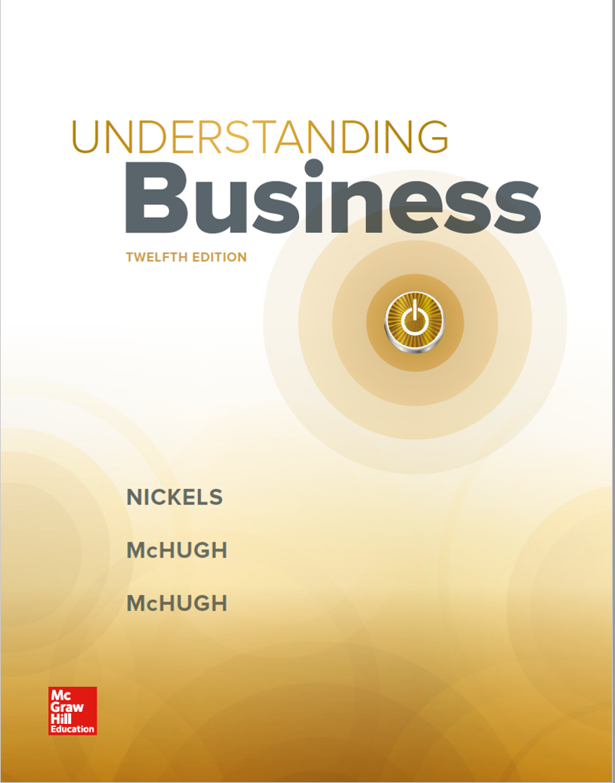
Chapter 16
Using Effective Promotions

Slide 2
Learning Objectives
LO 16-1 Identify the new and traditional tools that make up the promotion mix.
LO 16-2 Contrast the advantages and disadvantages of various advertising media, including the Internet and social media.
LO 16-3 Illustrate the steps of the B2B and B2C selling processes.
LO 16-4 Describe the role of the public relations department, and show how publicity fits in that role.
LO 16-5 Assess the effectiveness of various forms of sales promotion, including sampling.
LO 16-6 Show how word of mouth, viral marketing, social networking, blogging, podcasting, e-mail marketing, and mobile marketing work.

Slide 3
Promotion and the Promotion Mix
Promotion mix — The combination of promotional tools an organization uses.
Integrated marketing communication (IMC) — A technique that combines the promotional tools into one comprehensive and unified promotional strategy.
IMC is used to:
Create a positive brand image
Meet the needs of consumers
Meet the strategic marketing and promotional goals of the firm
LO 16-1

Slide 4
Figure 16.1 The Traditional Promotion Mix
LO 16-1

Slide 5
Figure 16.2 Steps in a Promotional Campaign
Identify a target market.
Define the objectives for each element of the promotion mix.
Determine a promotional budget.
Develop a unifying message.
Implement the plan.
Evaluate effectiveness.
LO 16-1

Slide 6
Advertising: Informing, Persuading, and Reminding 1 of 4
Advertising — Paid, nonpersonal communication through various media by organizations and individuals who are in some way identified in the advertising message.
Impact of Advertising
Total advertising expenditures exceed $420 billion in 2016.
Consumers benefit because production costs of TV programs, radio programs, newspapers, and magazines are paid for by advertisers.
Marketers choose ad media that will reach the target market.
LO 16-2

Slide 7
Figure 16.3 Major Categories of Advertising 1 of 2
Retail advertising —to consumers by various retail stores
Trade advertising —to wholesalers and retailers by manufacturers
Business-to-business advertising —from manufacturers to other manufacturers
Institutional advertising — to create attractive image for organization rather than for product
Product advertising — to create interest among consumer, commercial, and industrial buyers
LO 16-2

Slide 8
Figure 16.3 Major Categories of Advertising 2 of 2
Advocacy advertising — supports particular view of issue
Comparison advertising — compares competitive products
Interactive advertising — enables customers to choose the information they receive
Online advertising — appear on computers as people visit different websites
Mobile advertising — reaches people on their smartphones
LO 16-2

Slide 9
Figure 16.4 Estimated U.S. Advertising Expenditure in 2016 by Medium (in Billions of Dollars)
LO 16-2
Jump to long description in appendix

Slide 10
Advertising: Informing, Persuading, and Reminding 2 of 4
Television Advertising
TV advertising is still the dominant media.
DVRs and OnDemand services challenge TV advertising because viewers can skip ads.
Product Placement
Product placement – Putting products into TV shows and movies where they will be seen.
LO 16-2

Slide 11
Advertising: Informing, Persuading, and Reminding 3 of 4
Infomercials
Infomercial — A full-length TV program devoted exclusively to promoting goods or services.
Online Advertising
Online ads are attempts to get potential customers to a website to learn about a product.
Interactive promotion — Promotion process that allows marketers to go beyond a monologue, where sellers try to persuade buyers to buy things, to a dialogue in which buyers and sellers work together to create mutually beneficial exchange relationships.
LO 16-2

Slide 12
Advertising: Informing, Persuading, and Reminding 4 of 4
Social Media Advertising
Companies can measure how many times a post is viewed or shared.
Social media allows marketers to test promotions before bringing them to traditional media.
Global Advertising
Requires marketers to develop a single product and promotional strategy to implement worldwide
Problems can arise in global markets with using one advertising campaign in all countries—especially bad translations.
Many marketers are moving from globalism to regionalism.
LO 16-2

Slide 13
Personal Selling: Providing Personal Attention 1 of 4
Personal selling — The face-to-face presentation and promotion of goods and services.
Salespeople need to listen to customer needs, help reach a solution, and do everything possible to make the transaction as simple as possible.
LO 16-3

Slide 14
Personal Selling: Providing Personal Attention 2 of 4
Steps in the Selling Process
Prospect and qualify
Preapproach
Approach
Make a presentation
Answer objections
Close the sale
Trial close — A question or statement that moves the selling process toward the actual close.
Follow up
LO 16-3

Slide 15
Personal Selling: Providing Personal Attention 3 of 4
Steps in the Selling Process continued
Prospecting and Qualifying
Prospecting — Researching potential buyers and choosing those most likely to buy.
Qualifying — Making sure that people have a need for the product, the authority to buy, and the willingness to listen to a sales message.
Prospect — A person with the means to buy a product, the authority to buy, and the willingness to listen to a sales message.
LO 16-3

Slide 16
Personal Selling: Providing Personal Attention 4 of 4
The Business-to-Consumer Sales Process
Most of these sales take place in retail stores.
The salesperson does not have to do much prospecting or qualifying.
Retail salespeople don’t usually need a preapproach step.
Follow up if the product is to be delivered or installed.
LO 16-3

Slide 17
Figure 16.6 Steps in the Business-to-Consumer (B2C) Selling Process
LO 16-3

Slide 18
Public Relations: Building Relationships 1 of 3
Public relations (PR) — The management function that evaluates public attitudes, changes policies and procedures in response to the public’s requests, and executes a program of action and information to earn public understanding and acceptance.
Three steps of a good PR program:
Listen to the public.
Change policies and procedures.
Inform people you’re responsive to their needs.
LO 16-4

Slide 19
Public Relations: Building Relationships 2 of 3
Publicity: The Talking Arm of PR
Publicity — Any information about an individual, product, or organization that’s distributed to the public through the media and that’s not paid for or controlled by the seller.
Advantages of publicity:
Free
Reaches people who would not look at an advertisement
More believable than advertising
LO 16-4

Slide 20
Public Relations: Building Relationships 3 of 3
Publicity: The Talking Arm of PR continued
Disadvantages of publicity:
No control over whether the media will use a story or when they may release it.
It can be good or bad.
Once a story has been run, it is not likely to run again.
LO 16-4

Slide 21
Sales Promotion: Giving Buyers Incentives
Sales Promotion — The promotional tool that stimulates consumer purchasing and dealer interest by means of short-term activities.
Categories of Sales Promotions:
B2B sales promotions
Consumer sales promotions
Key Consumer Promotions
Samples
Coupons
Contests and prizes
LO 16-5

Slide 22
Figure 16.7 Sales Promotion Techniques
LO 16-5
Jump to long description in appendix

Slide 23
Word of Mouth and Other Promotional Tools 1 of 4
Word-of-mouth promotion — People tell others about products they have purchased.
Viral marketing — Paying customers to say positive things on the Internet or setting up multiple selling schemes whereby consumers get commissions for directing friends to specific websites.
Many viral marketing programs give away free products or services in exchange for e-mail addresses.
LO 16-6

Slide 24
Word of Mouth and Other Promotional Tools 2 of 4
Social Networking
Steps to launch a successful promotional campaign:
Know your customer base.
Post something new every day.
Develop fun, suitable hashtags.
Use a publishing calendar.
Engage with customers through contests and entertainment.
Follow back and reply to commenters.
Familiarize yourself with new site features.
Measure the effectiveness of posts.
LO 16-6

Slide 25
Word of Mouth and Other Promotional Tools 3 of 4
Blogging
Blogs are a great way to interact with customers and improve the company’s website ranking.
Podcasting
Podcasting — A means of distributing audio and video programs via the Internet that lets users subscribe to a number of files, also known as feeds, and then hear or view the material at the time they choose.
LO 16-6

Slide 26
Word of Mouth and Other Promotional Tools 4 of 4
E-Mail Promotions
E-mail promotions increase brand awareness among commercial suppliers.
Mobile Marketing
Marketers make use of smartphones to text customers about product offers and other company information.
LO 16-6

Slide 27
Managing the Promotion Mix: Putting It All Together
Promotional Strategies
Push strategy — The producer uses advertising, personal selling, sales promotion, and all other promotional tools to convince wholesalers and retailers to stock and sell merchandise.
Pull strategy — Heavy advertising and sales promotion efforts are directed toward consumers so that they’ll request the products from retailers.
LO 16-6

Slide 28
Appendix of Long Image Descriptions

Slide 29
Appendix 1 Figure 16.4 Estimated U.S. Advertising Expenditure in 2016 by Medium (in Billions of Dollars)
From highest to lowest projected advertising spending:
TV: approximately 37 billion dollars
Digital: approximately 35 billion dollars
Radio: approximately 8 billion dollars
Newspapers: approximately 7.5 billion dollars
Magazines: approximately 7 billion dollars
Outdoor: approximately 4 billion dollars
Directories: approximately 2 billion dollars
Return to original slide

Slide 30
Appendix 2 Figure 16.7 Sales Promotion Techniques
B2B promotion techniques include trade shows, portfolios for salespeople, deals (price reductions), catalogs, and conventions.
B2C promotion techniques include coupons, cents-off promotions, sampling, premiums, sweepstakes, contests, bonuses (buy one, get one free), catalogs, demonstrations, special events, lotteries, and in-store displays.
Return to original slide

