Slide 1
Chapter 11 Preparing a Worksheet for a Merchandise Company

Slide 2
Learning Objectives
How to record Adjustments for :
Merchandise Inventory
Unearned Rent
Supplies Used
Insurance Expired
Depreciation Expense
Salaries Accrued
Preparing a Worksheet for a Merchandise Company
Notes:
Learning Objectives
Figuring Adjustments for Merchandise Inventory, Unearned Rent, Supplies Used, Insurance Expired, Depreciation Expense, and Salaries Accrued
Preparing a Worksheet for a Merchandise Company

Slide 3
Learning Objective 1
Figuring Adjustments for Merchandise Inventory, Unearned Rent, Supplies Used, Insurance Expired, Depreciation Expense, and Salaries Accrued
Notes:
The first learning objective is “Figuring Adjustments for Merchandise Inventory, Unearned Rent, Supplies Used, Insurance Expired, Depreciation Expense, and Salaries Accrued.”

Slide 4
Adjustments for Merchandise Inventory-Periodic System
Beginning inventory account
is the starting inventory for the period that never changes during the period
Purchases account
Includes all purchases of merchandise, made during the period.
Ending inventory account
Is the amount at the end of the period
the company takes a physical count of the merchandise in stock
Notes:
Assume Art’s Wholesale Clothing Company started the year with $19,000 worth of merchandise. This merchandise is called beginning merchandise inventory or simply beginning inventory. The balance of beginning inventory never changes during the accounting period. Instead, all purchases of merchandise are recorded in the Purchases account. During the accounting period, $52,000 worth of such purchases were made and recorded in the Purchases account.
At the end of the period, the company takes a physical count of the merchandise in stock; this amount is called ending merchandise inventory or simply ending inventory.

Slide 5
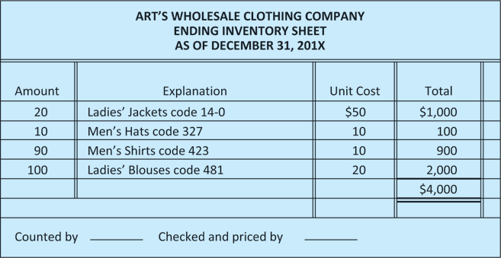
Adjustments for Merchandise Inventory-Periodic System
Ending inventory
is calculated on an inventory sheet when they take a physical count.
Figure 11.1 Ending Inventory Sheet
Notes:
At the end of the period, the company takes a physical count of the merchandise in stock; this amount is called ending merchandise inventory or simply ending inventory. It is calculated on an inventory sheet as shown in Figure 11.1. This $4,000, which is the ending inventory for this period, will be the beginning inventory for the next period.

Slide 6
Adjusting Merchandise Inventory involves a two-step process:
First, remove the beginning inventory
Notes:
Adjusting the Merchandise Inventory account is a two-step process because we must record the beginning inventory and ending inventory amounts separately. The first step deals with beginning merchandise inventory.
Given: Beginning Inventory, $19,000
Our first adjustment removes beginning inventory from the asset account (Merchandise Inventory) and transfers it to Income Summary. We do so by crediting Merchandise Inventory for $19,000 and debiting Income Summary for the same amount.

Slide 7
Two-step process includes:
Remove the beginning inventory
Add ending inventory
Notes:
The second step is entering the amount of ending inventory ($4,000) in the Merchandise Inventory account. This step is done to record the amount of goods on hand at the end of the period as an asset and to subtract this amount from the cost of goods sold (because we have not sold this inventory yet). To do so, we debit Merchandise Inventory for $4,000 and credit Income Summary for the same amount.

Slide 8
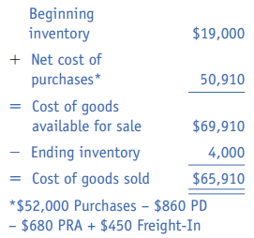
Periodic System
Income Statement impact
Beginning Inventory
Sales Revenue
- Cost Of Goods Sold
= Gross Profits or Gross Margin
- General, Selling, and Administrative Expenses
= Net Income or Net Loss
Cost of Goods Sold
Purchases $52,000
Purchase Discount 860
Purchase Returns 680
$50,460
+ Freight In 450
Net Purchases $50,910
Net Purchases
Notes:
Let’s look at how this process or method of recording merchandise inventory is reflected in the balance sheet and income statement. Note that the $19,000 of beginning inventory is assumed sold and is shown on the income statement as part of the cost of goods sold. The ending inventory of $4,000 is assumed not to be sold and is subtracted from the cost of goods sold on the income statement.
Cost of goods available for sale is calculated by adding net purchases and freight-in charges to the beginning inventory. After calculating cost of goods available for sale, ending inventory is subtracted to calculate cost of goods sold.

Slide 9
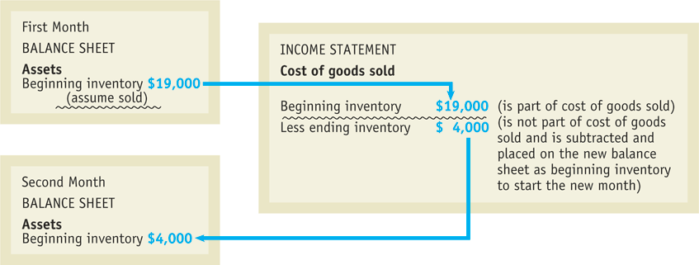
Balance Sheet & Income Statement impact
Figure 11.2
Reporting Inventory on a Partial Balance Sheet and Income Statement
Notes:
The ending inventory becomes next month’s beginning inventory on the balance sheet. When the income statement is prepared, we will need a figure for beginning inventory as well as a figure for ending inventory. The goal of this adjustment is to wipe out the old inventory (a cost) and show the new inventory (not yet a cost).

Slide 10
Let’s Practice
Under the periodic inventory system the beginning inventory balance:
a) never changes.
b) is updated continuously.
c) is used to record purchases.
d) None of these are correct.

Slide 11
Let’s Practice
Under the periodic inventory system the beginning inventory balance:
a) never changes.
b) is updated continuously.
c) is used to record purchases.
d) None of these are correct.
ANSWER:
(L.O. 1, a)

Slide 12
Let’s Practice
Under Periodic Inventory System, to record the purchase of merchandise for resale the account debited is:
a) Sales.
b) Purchases.
c) Supplies.
d) Beginning Inventory.

Slide 13
Let’s Practice
Under Periodic Inventory System, to record the purchase of merchandise for resale the account debited is:
a) Sales.
b) Purchases.
c) Supplies.
d) Beginning Inventory.
ANSWER:
(L.O. 1, b)

Slide 14
Let’s Practice
The formula for cost of goods sold is:
a) Ending Inventory - Net Purchases + Beginning Inventory.
b) Net Purchases + Ending Inventory - Beginning Inventory.
c) Ending Inventory + Beginning Inventory - Purchases.
d) Beginning Inventory + Net Purchases - Ending Inventory.

Slide 15
Let’s Practice
The formula for cost of goods sold is:
a) Ending Inventory - Net Purchases + Beginning Inventory.
b) Net Purchases + Ending Inventory - Beginning Inventory.
c) Ending Inventory + Beginning Inventory - Purchases.
d) Beginning Inventory + Net Purchases - Ending Inventory.
ANSWER:
(L.O. 1, d)

Slide 16
Adjustments for Unearned Revenue
Unearned Revenue
is a liability account
Is Rent $ Received in Advance
It represents an amount collected for rent before renting the space
is earned as one fulfills a portion of the rental agreement.
Notes:
A second new account we have not seen before is a liability called Unearned Rent or Rent Received in Advance. This account records the amount collected for rent before the service (renting the space) has been provided.

Slide 17
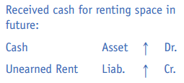
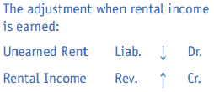
Adjustments for Unearned Revenue
For example:
A company is renting a portion of its space to a company for $200 per month and receives $600 for three (3) months 'rent paid in advance.
January 1st
Cash 600
Unearned Revenue 600
January 31st
Unearned Revenue 200
Rental Income 200
Notes:
Unearned rent is a liability until it is actually earned.

Slide 18
Let’s Practice
Unearned Rent is what type of account?
a) Asset
b) Liability
c) Revenue
d) Expense
Rental Income is what type of account?
a) Asset
b) Liability
c) Revenue
d) Expense

Slide 19
Let’s Practice
“Unearned Rent” is what type of account?
a) Asset
b) Liability
c) Revenue
d) Expense
ANSWER: (L.O. 1, b)
“Rental Income” is what type of account?
a) Asset
b) Liability
c) Revenue
d) Expense
ANSWER: (L.O. 1, c)

Slide 20
Learning Objective 2
Preparing a Worksheet for a Merchandise Company
Notes:
Learning Objective 2 is “Preparing a Worksheet for a Merchandise Company.”

Slide 21
Preparing a Worksheet for a Merchandise Company
Steps in completing a worksheet
Enter the trial balance in the first two columns
Enter the adjustments in the next two columns
Enter the totals from combining the first four columns to the adjusted trial balance columns
Fill out the income statement columns from the adjusted trial balance
Fill out the balance sheet columns from the adjusted trial balance
Notes:
Figure 11.5 shows the trial balance that was prepared on December 31, 200X, from Art’s Wholesale ledger. Note that it is placed directly in the first two columns of the worksheet. We already discussed the adjustments that make up the two-step process involved in adjusting Merchandise Inventory at the end of the accounting period. Other adjustments will need to be made at this point for a merchandise firm and will be shown later. Figure 11.6 shows the worksheet with the adjustments and adjusted trial balance columns filled out. Note that the adjustment numbers in the Income Summary from beginning and ending inventory are also carried over to the adjusted trial balance and are not combined. The next step in completing the worksheet is to fill out the income statement columns from the adjusted trial balance, as shown in Figure 11.7. The next step in completing the worksheet is to fill out the balance sheet columns (see Figure 11.8). Note how ending inventory is carried over to the balance sheet from the adjusted trial balance column.

Slide 22
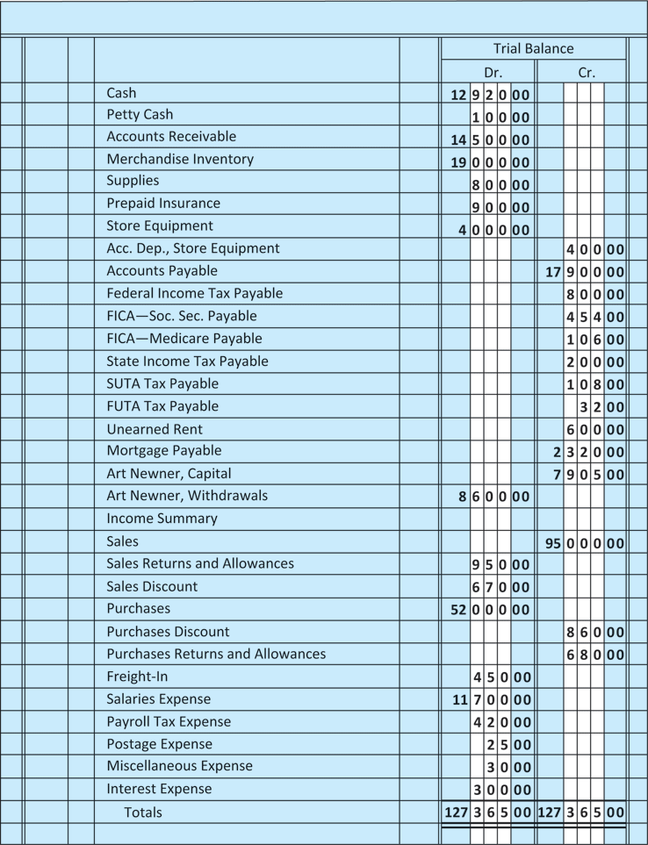
Enter the trial balance
Figure 11.4
Trial Balance Section
of the Worksheet
Notes:
Figure 11.5 shows the trial balance that was prepared on December 31, 200X, from Art’s Wholesale ledger. Note that it is placed directly in the first two columns of the worksheet. In looking at the trial balance, we see many new titles that appeared after we completed a trial balance for a service company in Chapter 5.

Slide 23
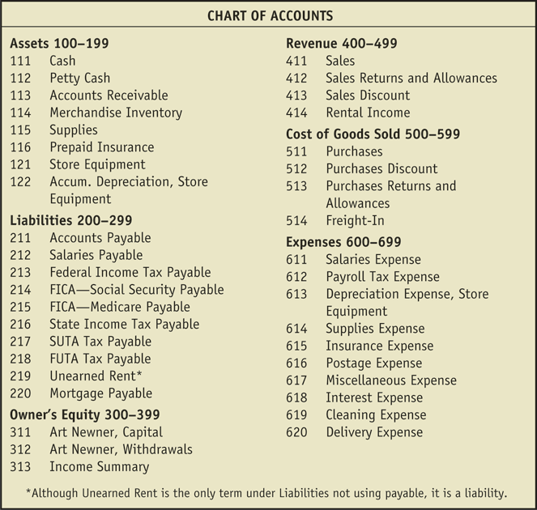
New Accounts Are Added As Needed
Figure 11.3 Art’s Wholesale Clothing Company Chart of Accounts
Notes:
In looking at the trial balance, we see many new titles that appeared after we completed a trial balance for a service company in Chapter 5.

Slide 24
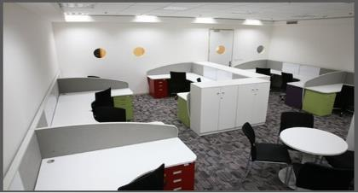
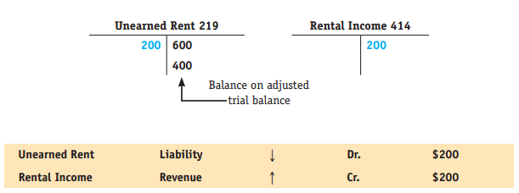
Adjustment C: Rental Income Earned
Now, $200 has been earned because the rental services have been provided.
January 31st Adjusting Entry
Unearned Revenue 200
Rental Income 200
Notes:
We already discussed the adjustments that make up the two-step process involved in adjusting Merchandise Inventory at the end of the accounting period. Now we show T accounts and transaction analysis charts for other adjustments that need to be made at this point for a merchandise firm, just as they must for a service company.
Adjustment C: Rental Income Earned by Art’s Wholesale, $200 A month ago, Cash was increased by $600, as was a liability, Unearned Rent. Art’s Wholesale received payment in advance but had not earned the rental income. Now, because $200 has been earned, the liability is reduced and Rental Income can be recorded for the $200.

Slide 25
Adjustment D: Supplies on Hand
Supplies on Hand were $300 but they bought $800 at the beginning of the accounting period.
$800 - $300 on hand = $500 worth of supplies were used
January 31st Adjusting Entry
Supplies Expense 500
Supplies 500
Notes:
Adjustment D: Supplies on Hand, $300
Because $500 worth of supplies were used, Supplies Expense is increased and the asset Supplies is decreased.

Slide 26
Let’s Practice
The adjustment for supplies used would be to:
a) debit Supplies; credit Supplies Expense.
b) debit Supplies Used; credit Cash.
c) debit Supplies Expense; credit Supplies.
d) debit Supplies; credit Cash.
The adjustment for unearned rent is recorded when:
a) cash is received.
b) rent is earned.
c) revenue is received.
d) closing entries are prepared.

Slide 27
Let’s Practice
The adjustment for supplies used would be to:
a) debit Supplies; credit Supplies Expense.
b) debit Supplies Used; credit Cash.
c) debit Supplies Expense; credit Supplies.
d) debit Supplies; credit Cash.
ANSWER: (L.O. 1, c)
The adjustment for unearned rent is recorded when:
a) cash is received.
b) rent is earned.
c) revenue is received.
d) closing entries are prepared.
ANSWER: (L.O. 1, b)

Slide 28
Adjustment E: Insurance Expired
On January 31, $300 insurance has expired.
January 31st Adjusting Entry
Insurance Expense 300
Prepaid Insurance 300
Notes:
Adjustment E: Insurance Expired, $300
Because insurance has expired by $300, Insurance Expense is increased by $300 and the asset Prepaid Insurance is decreased by $300.

Slide 29
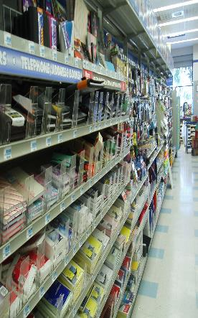
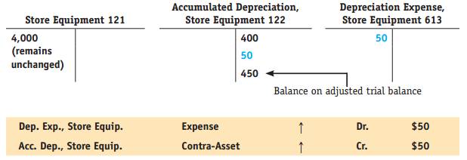
Adjustment F: Depreciation Expense
Recognize Depreciation Expense of $50.
Cost of the store equipment remains $4,000
January 31st Adjusting Entry
Depreciation Expense 50
Accumulated Depreciation 50
Notes:
Adjustment F: Depreciation Expense, $50
When depreciation is taken, Depreciation Expense and Accumulated Depreciation are both increased by $50. Note that the cost of the store equipment remains the same.

Slide 30
Let’s Practice
Accumulated Depreciation-Buildings should be shown on the:
a) income statement as an expense.
b) balance sheet as a current liability.
c) balance sheet as a contra account to Buildings.
d) balance sheet as a contra account to the owner's capital account.

Slide 31
Let’s Practice
Accumulated Depreciation-Buildings should be shown on the:
a) income statement as an expense.
b) balance sheet as a current liability.
c) balance sheet as a contra account to Buildings.
d) balance sheet as a contra account to the owner's capital account.
ANSWER: (L.O. 1, c)

Slide 32
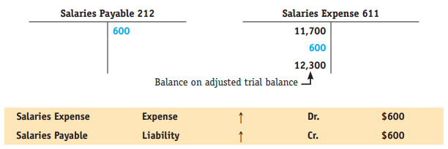
Adjustment G: Salaries Accrued
Now, accrued salaries for $600.
January 31st Adjusting Entry
Salaries Expense 600
Salaries Payable 600
Notes:
Adjustment G: Salaries Accrued, $600
The $600 in accrued salaries causes an increase in Salaries Expense and Salaries Payable.

Slide 33
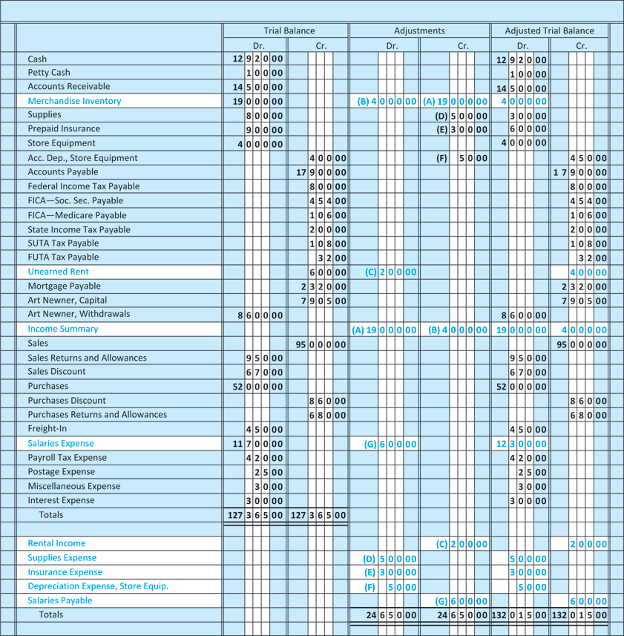
Worksheet With Adjustments
Figure 11.5 Worksheet with Six Columns
Notes:
Figure 11.5 shows the worksheet with the adjustments and adjusted trial balance columns filled out. Note that the adjustment numbers in the Income Summary from beginning and ending inventory are also carried over to the adjusted trial balance and are not combined.

Slide 34
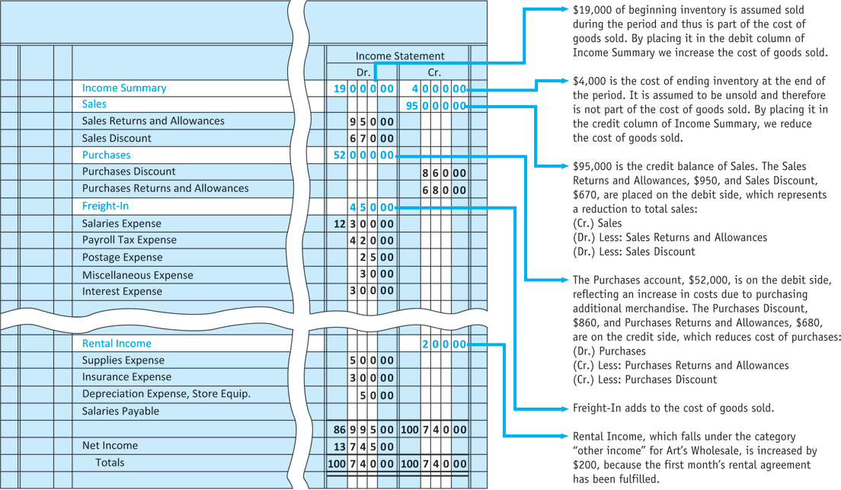
Fill out income statement columns
Figure 11.6 Income Statement Section of the Worksheet
Notes:
The next step in completing the worksheet is to fill out the income statement columns from the adjusted trial balance. We do not combine the $19,000 and $4,000 in Income Summary. When we prepare the cost of goods sold section for the formal income statement, we will need both a beginning and an ending figure for inventory.

Slide 35
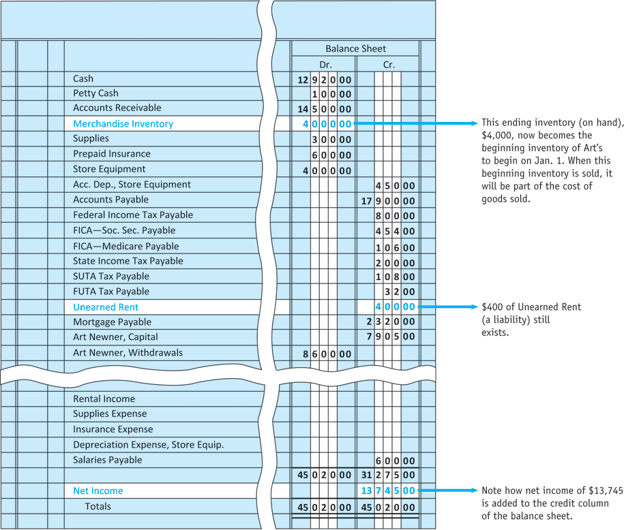
Fill Out The Balance Sheet Columns
Figure 11.7 Balance Sheet Section of the Worksheet
Notes:
The next step in completing the worksheet is to fill out the balance sheet columns (Fig. 11.8). Note how ending inventory is carried over to the balance sheet from the adjusted trial balance column. Take time also to look at the placement of the payroll tax liabilities as well as Unearned Rent on the worksheet.

Slide 36
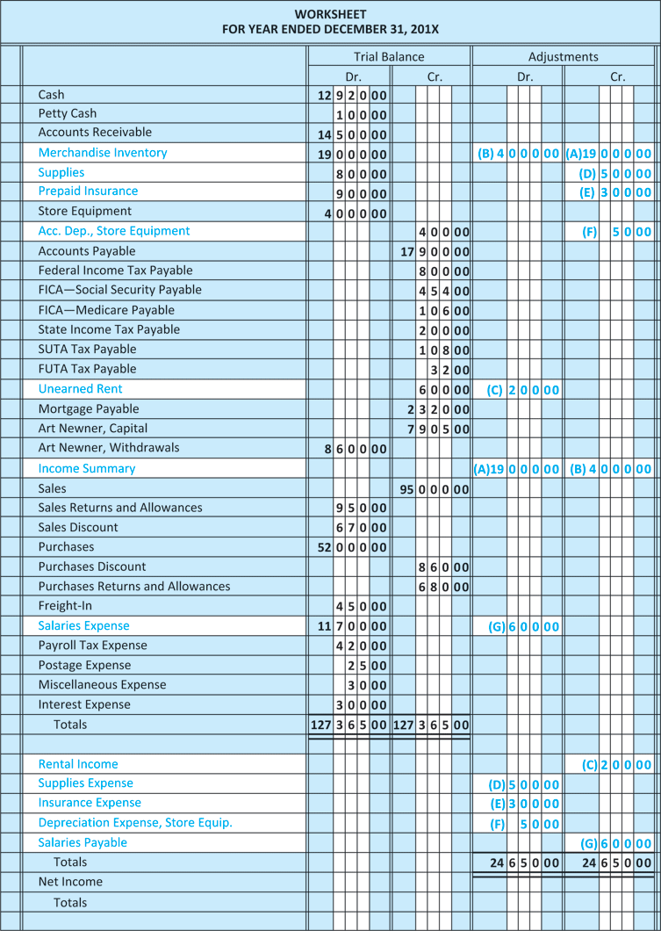
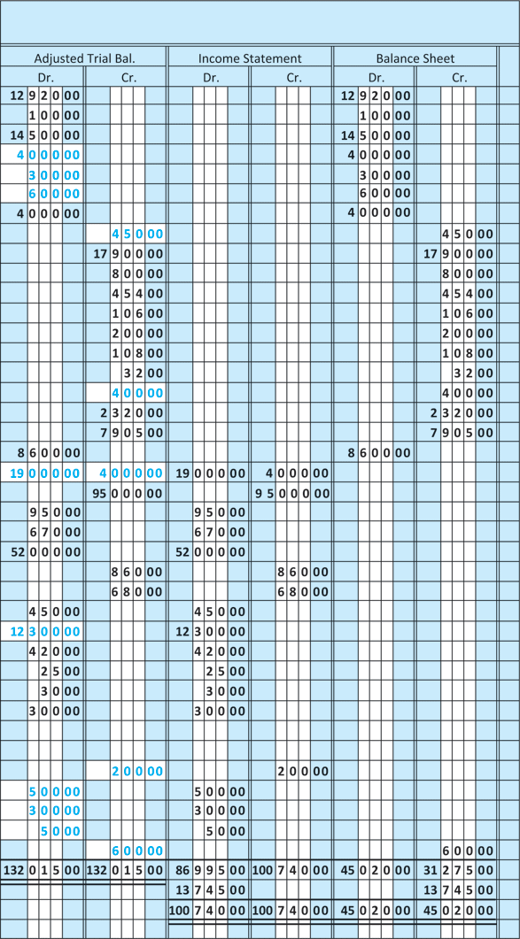
Figure 11.8 Completed Worksheet
Notes:
The income statement and balance sheet portions must also balance. Net income is carried over to the credit column of the balance sheet to verify everything balances.

Slide 38
Summary of the chapter
The periodic inventory system updates the record of goods on hand only at the end of the accounting period.
Used for companies with a variety of merchandise with low unit prices.
With computers today, many companies switch to a perpetual inventory system.
In the periodic inventory system, additional purchases of merchandise during the accounting period will be recorded in the Purchases account.
The amount in beginning inventory
will remain unchanged during the accounting period.
At the end of the period, a new figure for ending inventory will be calculated.
Notes:
The periodic inventory system updates the record of goods on hand only at the end of the accounting period. This system is used for companies with a variety of merchandise with low unit prices. With computers today, many companies switch to a perpetual inventory system.
In the periodic inventory system, additional purchases of merchandise during the accounting period will be recorded in the Purchases account. The amount in beginning inventory will remain unchanged during the accounting period. At the end of the period, a new figure for ending inventory will be calculated.

Slide 39
Summary of the chapter
Beginning inventory at the end of the accounting period is part of the cost of goods sold, whereas ending inventory is a reduction to cost of goods sold.
The perpetual inventory system keeps a continuous record of inventory.
It is used by companies with high amounts of inventory.
Net sales less cost of goods sold equals gross profit.
Gross profit less operating expenses equals net income.
Notes:
Beginning inventory at the end of the accounting period is part of the cost of goods sold, whereas ending inventory is a reduction to cost of goods sold.
The perpetual inventory system keeps a continuous record of inventory. It is used by companies with high amounts of inventory.
Net sales less cost of goods sold equals gross profit. Gross profit less operating expenses equals net income.

Slide 40
Summary of the chapter
Unearned Revenue is a liability account that accumulates revenue that has not been earned yet, although the cash has been received.
It represents a liability to the seller until the service or product is performed or delivered.
Two important adjustments in the accounting for a merchandise company deal with:
the Merchandise Inventory account
the Unearned Revenue account (unearned rent).
When a company delivers goods or services for which it has been paid in advance, an adjustment is made to reduce the liability account Unearned Revenue and to increase an earned revenue account.
Notes:
Unearned Revenue is a liability account that accumulates revenue that has not been earned yet, although the cash has been received. It represents a liability to the seller until the service or product is performed or delivered.
Two important adjustments in the accounting for a merchandise company deal with the Merchandise Inventory account and with the Unearned Revenue account (unearned rent).

Slide 41
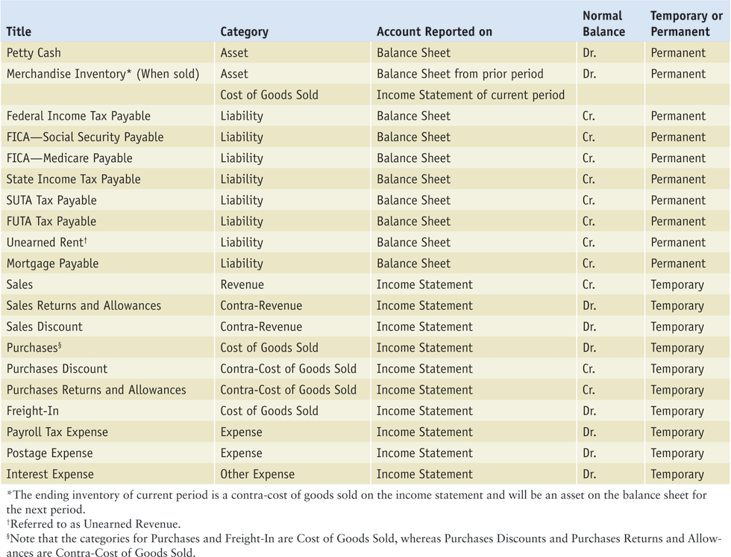
Table 11.1 Summary of New Account Titles

Slide 42
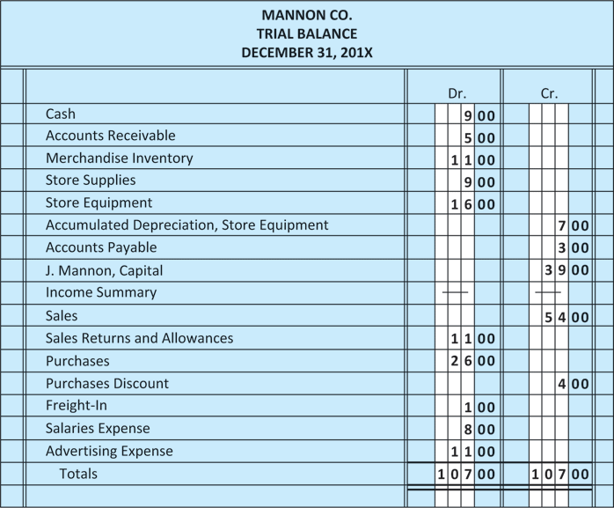
Figure 11.9 Trial Balance for Mannon Co.

Slide 43
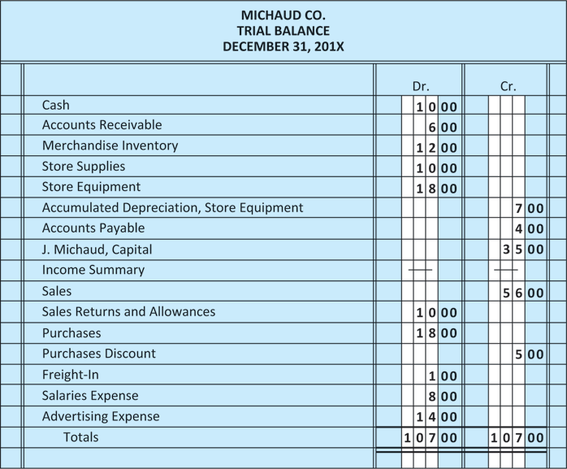
Figure 11.10 Trial Balance for Michaud Co.

Slide 44
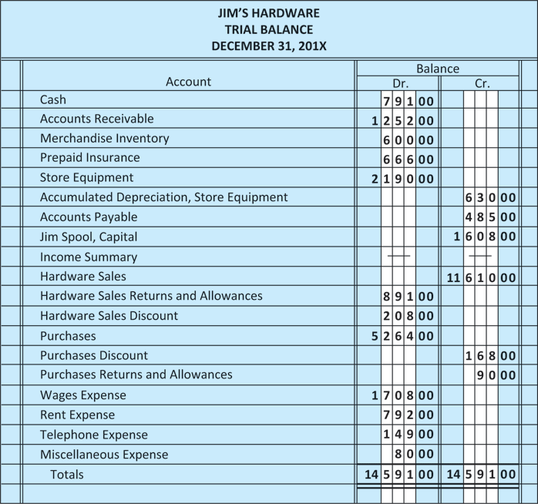
Figure 11.11 Trial Balance for Jim’s Hardware

Slide 45
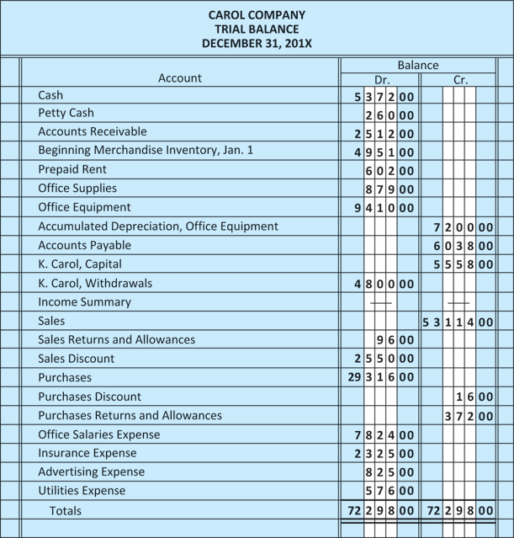
Figure 11.12 Trial Balance for Carol Company

Slide 46
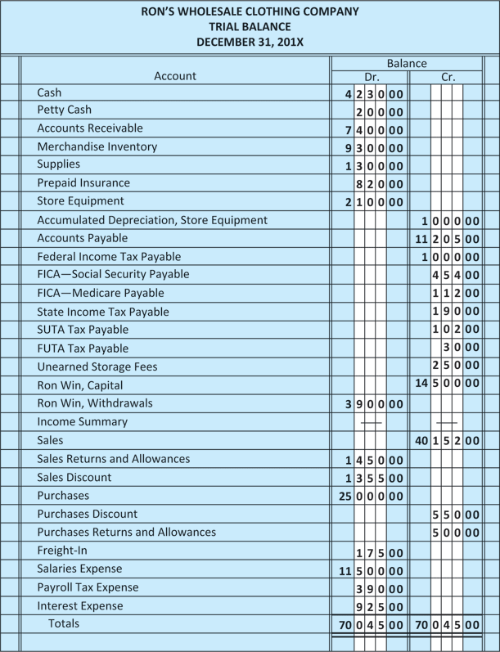
Figure 11.13 Trial Balance for Ron’s Wholesale Clothing Company

Slide 47
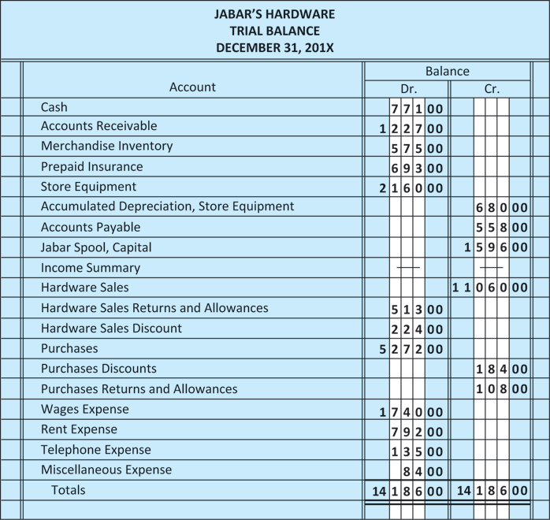
Figure 11.14 Trial Balance for Jabar’s Hardware

Slide 48
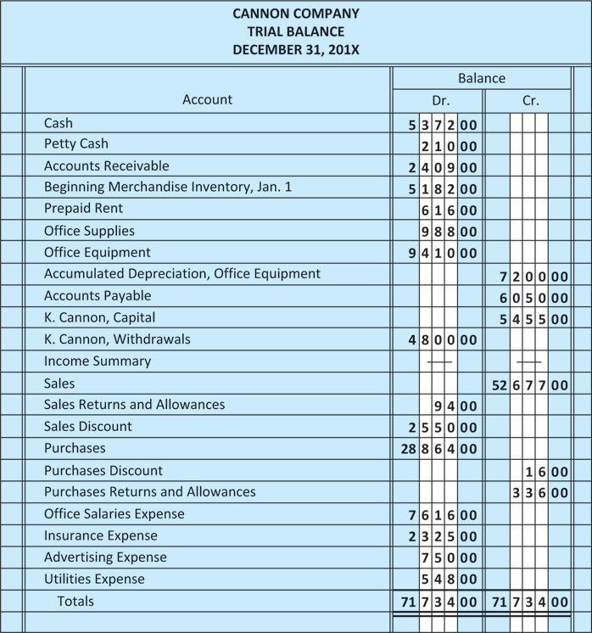
Figure 11.15 Trial Balance for Cannon Company

Slide 49
Figure 11.16 Trial Balance for Jack’s Wholesale Clothing Company

Slide 50
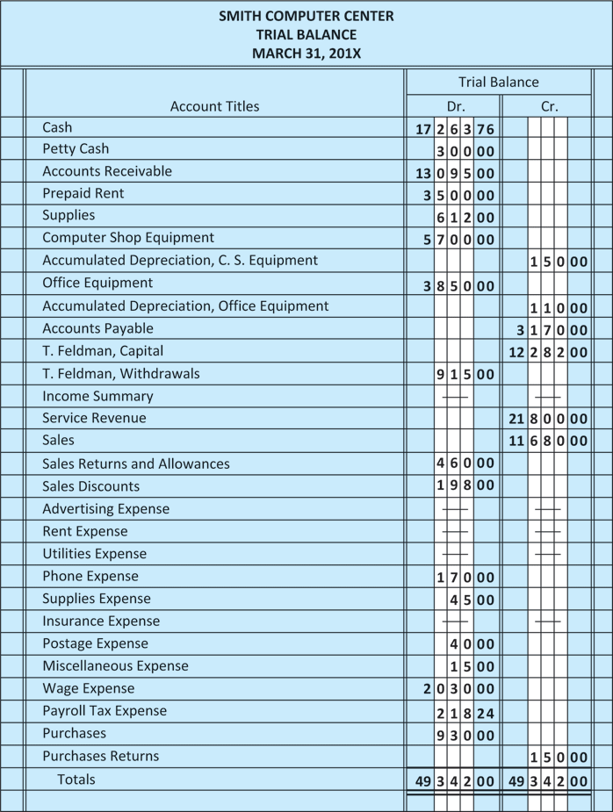
Figure 11.17 Trial Balance for Smith Computer Center

Slide 51
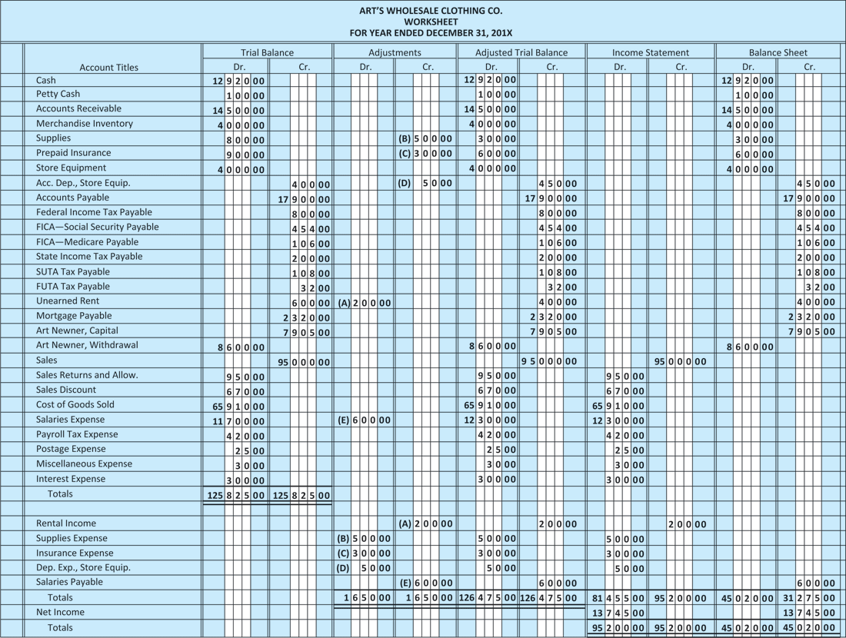
Figure 11A.1 Worksheet for Art’s Wholesale Clothing Company Using a Perpetual Inventory System

