Slide 1
Payroll Accounting A practical, real-world approach 8TH EDITION
Chapter 5: Federal and State Unemployment Taxes

Slide 2
Learning Objectives
After studying this chapter, you will be able to:
Calculate FUTA tax
Calculate SUTA tax
Determine matching employer taxes
Record an employer payroll tax journal entry
Account for nonemployee compensation
Calculate self-employment tax

Slide 3
Federal Unemployment Tax (FUTA)
Federal unemployment tax (FUTA) is levied on the employer.
It is based on the taxable earnings of employees.
The government uses these taxes for unemployment compensation provided to out-of-work individuals.
6% is levied on the first $7,000 of taxable wages.

Slide 4
Credit Reduction States
Certain states/territories may be subject to a credit reduction:
If a state receives a credit reduction, employers must pay higher FUTA.

Slide 5
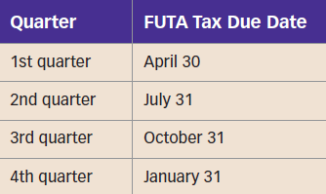
Making FUTA Tax Payments
These payments are usually remitted on a quarterly basis.
They are paid on the final day of the first month after the end of the quarter.

Slide 6
State Unemployment Tax (SUTA)
State unemployment tax (SUTA) is based on employees’ taxable earnings and is levied on the employer.
Three states (AK, NJ, and PA) also levy the SUTA tax on employees.
The number of laid-off employees affects SUTA taxes.
TIP! Employers are assigned a SUTA tax rate based on employee turnover. If no track record exists, the employer is assigned a new employer SUTA tax rate.

Slide 7
State Unemployment Tax (SUTA) (cont.)
SUTA tax rates and associated wage thresholds differ from state to state.
The SUTA Dumping Prevention Act of 2004 requires the state to ensure prior employee turnover impacts the SUTA tax rate.
A credit may be claimed for SUTA tax paid if an employee has worked in multiple states.

Slide 8
Matching Social Security and Medicare Tax
The employer must withhold and pay an equal amount of Social Security and Medicare tax from employees.
Taxes are expenses to employers.
Taxes are based on the level of employee earnings.

Slide 9
Accounting for Payroll (Employer Portion)
Journal entries:
The first entry records salaries expense and wages expense.
The second entry records payroll tax expenses paid by the employer.
Credits to Social Security Tax Payable and Medicare Tax Payable are identical to those in the prior entry.

Slide 10
Nonemployee Compensation
Independent contractors are workers who determine how the employer’s work is to be completed.
When an employer hires an independent contractor, it must complete the following forms:
Form W-9
Form 1099-NEC
Form 1096

Slide 11
Independent Contractors
The following professionals frequently work as independent contractors:
Accountants
Lawyers
Doctors
Subcontractors
If the employer cannot determine if the individual is an employee or an independent contractor, the IRS can decide.

Slide 12
Form W-9
The employer must report withholding taxes but does not withhold the compensation from the contractor.
The employer must obtain either the contractor’s Social Security number or Employer Identification Number.
The employer retains the completed Form W-9.

Slide 13
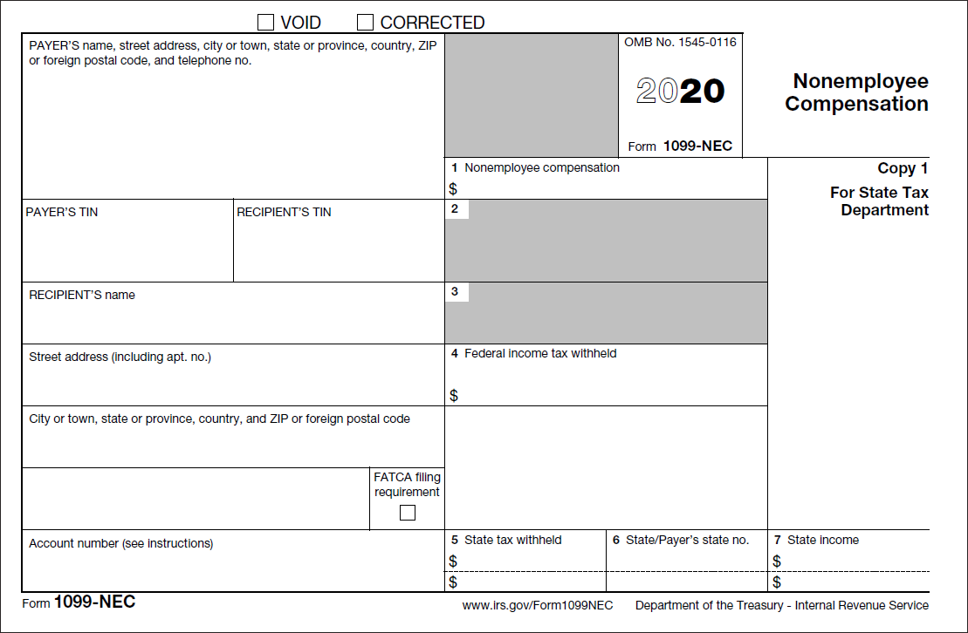
Form 1099-NEC
The employer must report gross earnings but does not withhold any compensation from the contractor.
The employer furnishes Form 1099-MISC to the independent contractor and the IRS.

Slide 14
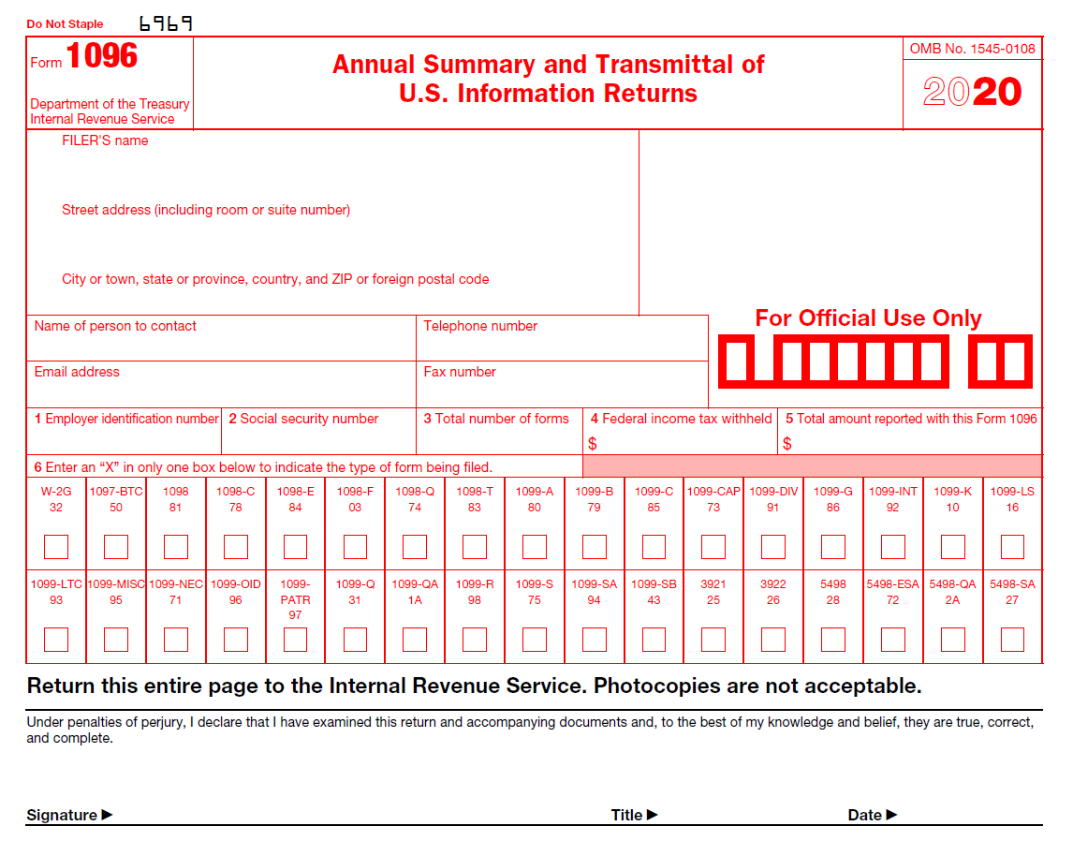
Form 1096
This form summarizes all compensation paid to every independent contractor.

Slide 15
The Self-Employment Contributions Act (SECA)
This was established for self-employed individuals.
The net self-employment income equals the income after subtracting the business’s expenses.
The taxable earnings threshold applies.

