Slide 1
Payroll Accounting A practical, real-world approach 8TH EDITION
Chapter 1: Processing a New Employee

Slide 2
Learning Objectives
After studying this chapter, you will be able to:
Define the Fair Labor Standards Act
Utilize Circular E
Complete various forms for new employees
Convey the importance of workers’ compensation insurance
Create an employee earnings record

Slide 3
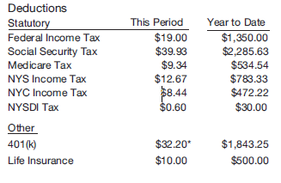
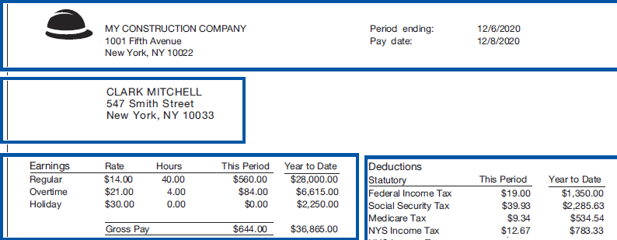
The Employee Paystub
Paystubs list amounts not included in your check.
Other information (company, pay period, employee information) is also found on the paystub.

Slide 4
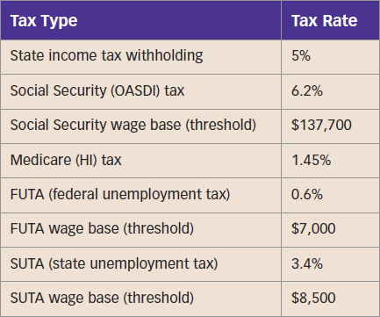
The Employee Paystub (cont.)
Using the Summary of Tax Rates
Refer to these tax rates throughout the book:

Slide 5
The Fair Labor Standards Act (FLSA)
Employers must ensure compliance with the Fair Labor Standards Act.
It establishes a federal minimum wage.
It establishes the overtime wages rate.
It establishes child labor restrictions.
The FLSA contains many other provisions and allows a wide range of exemptions.

Slide 6
The Federal Minimum Wage
U.S. Congress sets the federal minimum wage.
Individual states may also pass their own minimum wage laws.
When state-established rates disagree with the federal rate, the larger wage prevails.

Slide 7
Exceptions to the Federal Minimum Wage
Workers with disabilities
Full-time students
Young workers
Tipped employees
Student learners

Slide 8
Who Must Pay the Minimum Wage?
The minimum wage applies to people employed by:
Large businesses (revenues of $500,000+)
Governmental agencies (local, state, or federal)
Hospitals
Schools
It also covers domestic workers and employees working for interstate commerce businesses.

Slide 9
Calculating Overtime Wages
Hours worked over 40 in a workweek are paid at 1.5 times regular wages (“time and a half”).
Certain employees are exempt, such as executive, administrative, and professional workers.

Slide 10
Child Labor Restrictions
Restrictions vary depending on age groups:
Under 14 years of age – May only perform specific activities
Ages 14 and 15 – May work a variety of jobs but are subject to extensive hour limitations
Ages 16 and 17 – May work an unlimited number of hours
WARNING! No child under 17 may work in a job classified as hazardous.

Slide 11
Circular E
An employer’s tax guide written by the IRS
Benefits provided include:
Due dates for payroll forms
Instructions for calculating tax withholding
A summary of regulations
IRS contact information
Publication 15-T
Supplements Circular E
Contains complete tables for calculating federal income tax withholding

Slide 12
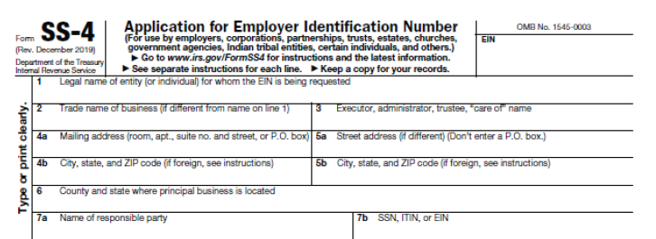
Form SS-4
Complete Form SS-4 to obtain an Employer Identification Number (EIN).

Slide 13
Hiring an Employee
The Personal Responsibility and Work Opportunity Reconciliation Act of 1996 enables better enforcement of child-support laws.
Complete Form SS-5 to obtain a Social Security number.

Slide 14
Form W-4
Every employee must complete Form W-4.
It provides information necessary to calculate both federal income tax withholding and applicable state income tax withholding
There is a revised form this year.
All new employees complete the 2020 version.
Old employees do not need to complete the new version unless changing withholdings.

Slide 15
Form W-4 (cont.)
In the 2019 and earlier versions of the W-4, the Personal Allowances Worksheet helps the employee determine the number of allowances to claim.
These are then used within tax withholding tables to determine the appropriate amount of federal income tax withholding for each pay period.

Slide 16
Additional Hiring Considerations
The Immigration Reform and Control Act of 1986
Intended to reduce illegal employment of foreign workers in the U.S.
Form I-9
Completed by the employee; acceptable documents are verified by the employer
E-Verify
Compares information from employee with that possessed by various government agencies

Slide 17
General Payroll Topics
Considerations prior to hiring employees:
Obtain workers’ compensation insurance
Obtain payroll certifications
Utilize payroll service providers
Establish employee earnings records

Slide 18
Workers’ Compensation Insurance
Required by most states
Provides financial assistance to employees injured on the job
Paid for by the employer
Premiums are based on the relative risk associated with different job types.

Slide 19
Payroll Certifications
The American Payroll Association offers two certifications:
Fundamental Payroll Certification (FPC)
Establishes a baseline level of payroll competency
Certified Payroll Professional (CPP)
Designates a higher level of payroll mastery

Slide 20
Utilizing a Payroll Service
Calculates employee net pay
Generates paychecks
Completes and files monthly, quarterly, and annual payroll tax forms

Slide 21
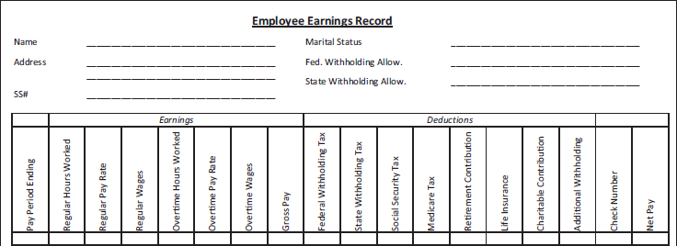
Employee Earnings Record
Contains key employee and payroll information
Summarizes annual payroll figures
Facilitates completion of payroll tax forms

