Slide 1
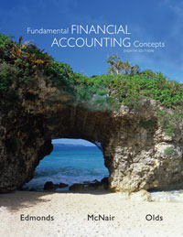
Principles of Financial Accounting Chapter 1

Slide 2
The Accounting Equation
Assets = Liabilities + Stockholders’ Equity

Slide 3
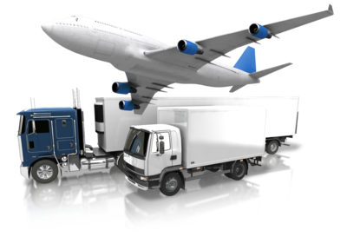
Assets
Assets represent economic resources. They have the ability or potential to provide future benefits to a company.

Slide 4
Liabilities
Liabilities are the obligations or debts that a company must pay in money or services at some time in the future.
Liabilities reflect the creditor’s claims on the assets of the company.

Slide 5
Stockholders’ Equity
Stockholders’ equity represents the owners’ claims on the assets of a company.

Slide 6
Two Parties Have a Claim to Assets
Creditors
Owner(s)

Slide 7
Who has a right to the company’s assets?
Creditor Claims=
Liabilities
Owner’s Claims=
Stockholders’ Equity

Slide 8
The Accounting Equation
Assets = Claims on Assets
Assets = Liabilities + Stockholders’ Equity
$1,000 = 300 + 700

Slide 9
What if the company went out of business?
Assets - Liabilities = Stockholders’ Equity
$1,000 - 300 = 700
Still SAME Equation?

Slide 10
Two Components of Stockholders’ Equity
Stockholders’ Equity
Common Stock + Retained Earnings
A stock certificate represents an ownership piece in the business.
Retained Earnings accumulates the profits of the business since inception less dividends.

Slide 11
Expanded Accounting Equation
Assets = Liabilities + Stockholders’ Equity
Assets = Liabilities + Common Stock + Retained Earnings
1,000 = 300 + ? + 500
How much stockholders’ Equity was contributed by the common stockholders?

Slide 12
Expanded Accounting Equation
Assets = Liabilities + Stockholders’ Equity
Assets = Liabilities + Common Stock + Retained Earnings
1,000 = 300 + 200 + 500

Slide 13
Questions so far…..

Slide 14
Preparing Financial Statements
Step 1: Income Statement
Step 2: Statement of Stockholders’ Equity
Step 3: Balance Sheet
Step 4: Statement of Cash Flows

Slide 15
Step 1: Income Statement
What is an income statement?
The income statement illustrates the Net Income or Net Loss of a company for a period of time.

Slide 16
Step 1: Income Statement
Income Statement For the year ended December 31
Revenues | $ 2,000
Expenses | (1,200)
Net Income | $ 800

Slide 17
Step 1: Income Statement
Revenues
Revenue is measured by the assets received in exchange for goods or services rendered.

Slide 18
Step 1: Income Statement
Expenses
The costs incurred by a company in the process of earning revenue.

Slide 19
Matching Concept
Step 1: Income Statement
Accrual accounting principles are designed to match expenses with revenues in the same reporting period.

Slide 20
Step 2: Statement of Stockholders’ Equity
Displays the changes in Stockholders’ Equity for a specified period of time.
Must transfer the Net Income (or Loss) from the Income Statement.

Slide 21
Step 2: Statement of Stockholders’ Equity
Step 1
Income Statement For the year ended December 31
Revenues | $ 2,000
Expenses | (1,200)
Net Income | $ 800
Statement of Changes in Stockholders’ Equity For the Year Ended December 31
Common Stock |  | $200
Beginning Retained Earnings | $ 0
Net Income | 800
Dividends | (300)
Ending Retained Earnings |  | 500
TOTAL Stockholder’s Equity |  | $700
Revenue and Expense account balances are “closed” at the end of the period and transferred to Stockholders’ Equity.

Slide 22
Step 3: Balance Sheet
What is a Balance Sheet?
The Balance Sheet presents a snap shot of a company’s financial position at a particular point in time.
Displays the components of the Accounting Equation.

Slide 23
The Accounting Equation
Assets = Liabilities + Stockholders’ Equity

Slide 24
Step 3: Balance Sheet
Balance Sheet As of December 31
Assets:
Cash | $ 600
Accounts Receivable | 350
Supplies | 50
Total Assets |  | $1,000
Liabilities
Accounts Payable |  | $ 300
Stockholders’ Equity
Common Stock | 200
Retained Earnings | 500
Total Stockholders’ Equity |  | $ 700
Total Liabilities and Stockholders’ Equity |  | $1,000
Step 2
Statement of Changes in Stockholders’ Equity For the Year Ended December 31
Common Stock |  | $200
Beginning Retained Earnings | $ 0
Net Income | 800
Dividends | (300)
Ending Retained Earnings |  | 500
TOTAL Stockholder’s Equity |  | $700

Slide 25
Step 4: Statement of Cash Flows
Displays cash inflows and outflows for a period of time. There are three categories presented on the Statement of Cash Flows:
Operating Activities
Investing Activities
Financing Activities

Slide 26
Statement of Cash Flows
Operating Activities- Inflows and outflows from and to customers and suppliers. Day to day operations of the business.
Investing Activities- Inflows from the sale of long-term assets and outflows for the purchase of long-term assets.
Financing Activities- Inflows from borrowing activities or issuing stock. Outflows to repay loans or dividends.

Slide 27
Summary of Financial Statements
Net Income transferred to Equity
Step 1: Income Statement
Step 2: Statement of Stockholders’ Equity
Step 3: Balance Sheet
Step 4: Statement of Cash Flows

